Slide 1
What is mentoring?
Understanding our role as mentors and avoiding professional oversteps.

Slide 2
Learning aims and objectives
To explore the mentoring role and it’s limitations.
To discuss what mentoring isn’t and popular misconceptions about the role.
To find out where the ‘edges’ are, and how different roles may seem to overlap.
To develop a better understanding of professional conduct and respect.
To ask questions.

Slide 3
So, who am I, and what do I know about mentoring?
Specialist Mentor at the University of Sussex and the University of Brighton (autism and mental health).
Autism mentor and adviser working with Hendrickx Associates, Access to Work, Autism Forward and privately through my own mentoring business (ASC Key Mentoring).
Nineteen year background of supporting autistic young people and adults in educational settings, work places and the community.
Autism lead and team leader for a personal support team at an F.E college for 10 years.

Slide 4
Mentoring and coaching.
Mentoring and coaching are often presumed to be the same thing, when actually they are very different:
A coach talks to you, a mentor talks with you.
Coaching is performance related and focused on the achievement of a specific goal.
Coaching is often business / corporate or sport related and goal orientated.
Coaching is driven by the coach, mentoring is driven by the mentee.

Slide 5
Mentoring and advocacy
Advocating on behalf of mentees is a common overstep for mentors.
It can be expected by mentees that advocacy is within the mentoring role and mentors may be asked to advocate on behalf of their mentee.
Professional advocates are required to complete specific training in order practice, especially if they work in legal, health / mental health or social care settings.
Attempting to advocate on behalf of a mentee is a boundary issue and a professionally inappropriate, it is also unlikely to be helpful, and may lead to additional issues.
?

Slide 6
Mentoring and counselling
Although mentors may use some counselling skills, such as active listening, open questions and summarising. It is important to remember that mentoring is not a substitute for therapeutic counselling.
Counsellors are required to complete very specific professional training, be accredited by a professional organisation and engage in their own therapeutic counselling and clinical supervision.
Opening up a dialogue with mentees about emotional / psychological challenges, mental health conditions or trauma is unsafe, it is also unlikely to be helpful for the mentee.
If a mentee continues to speak about emotional / psychological / mental health challenges with their mentor, after the boundaries have been agreed, then this must be reported and discussed in supervision.

Slide 7
Case study 1
As a newly appointed mentor on this project, you have been matched with a mentee, Paulo, and have scheduled your initial session with them for tomorrow.
Task: Discuss ways that you might approach this session, any resources you might bring, whether you might ask the mentee to bring anything and your main objective.

Slide 8
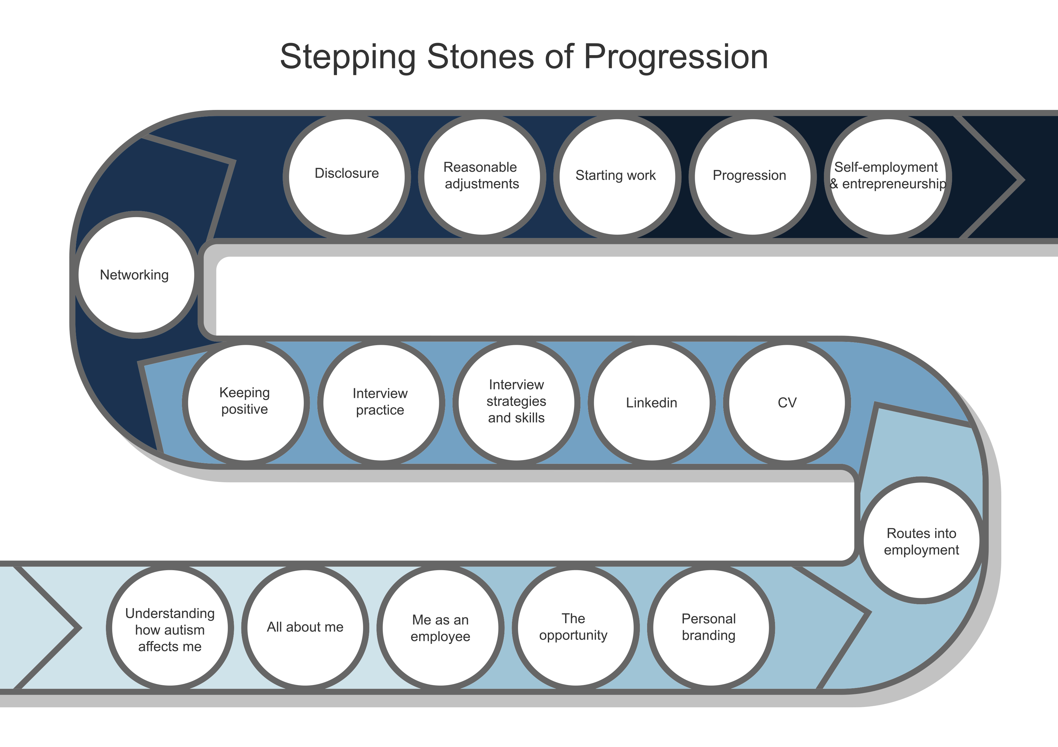

NDSA Tool Up programme
stepping stones
NDSA Tool Up programme
stepping stones
Goal(s)
Goal(s)

Slide 9
Case study 2
Enrique has had a patchy education background and
experienced significant challenges due to a late diagnosis and a
lack of relevant support and understanding. As a result, he has
not had much success in terms of gaining qualifications. With a
constellation of neurodivergence (autism, dyslexia and
dyspraxia), he tends to panic in environments where he is
required to produce written material or engage in fine motor
skills. He has interests in walking, fishing and looking after
horses and large animals, but has no real idea what he would
like to do.
Task: devise a plan that might work as a starting point for
activities to introduce to Enrique in order to focus his interests,
and help him with structuring his time around some set goals.

Slide 10
Case study 3
Saima has gained an undergraduate university degree in Music
a year ago. Although she was encouraged to look for work and
develop relevant networks and skills whilst on her course, she
found the dual demand of finishing her course and looking for
work exhausting, and this triggered a significant amount of
anxiety for her. As a result, her parents had advised her to
simply focus on her course work, but she now finds herself
unemployed, bored and feeling quite isolated. She would like to
access work, but needs support to do this.
Task: devise a plan that you might discuss through with Saima
to support her in setting some clear employment-related goals
to work towards.

Slide 11
Where are the ‘edges’ of my mentoring role?
Am I working towards specific goals with my mentee, which we have agreed collaboratively?
Am I ‘staying in my lane’ as a mentor, or do I feel tempted to stray into different roles, counsellor / advocate / coach / friend?
I am maintaining my boundaries and is my mentee respecting those boundaries?
I am using my supervision to openly discuss any concerns or reporting any issues?
I am encouraging my mentee to become more independent, develop skills and resilience, so that they can have agency and autonomy?
Am I working reflectively and keeping my journal / notes as agreed?

