Slide 1



Autism Spectrum Disorder and Sexual Offending (Online and Offline) and Terroristic Behaviours
Clare Allely
Professor of Forensic Psychology
University of Salford
c.s.allely@salford.ac.uk
Twitter @ClareAllely

Slide 2
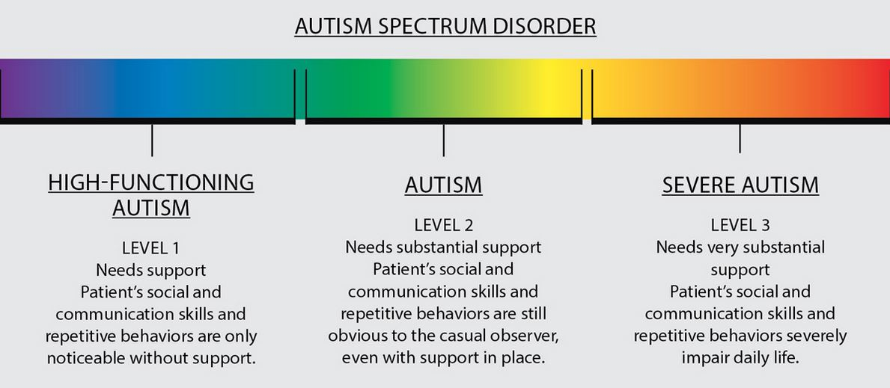
Autism
It is important to highlight that to think of someone with ASD as being on a spectrum (ranging from severely impaired to mildly impaired) is inaccurate. Rather, it is more appropriate and accurate to consider each person with ASD separately and their particular profile of strengths and weaknesses – in other words, that individual’s particular variation in ASD characteristics or features/traits.

Slide 3
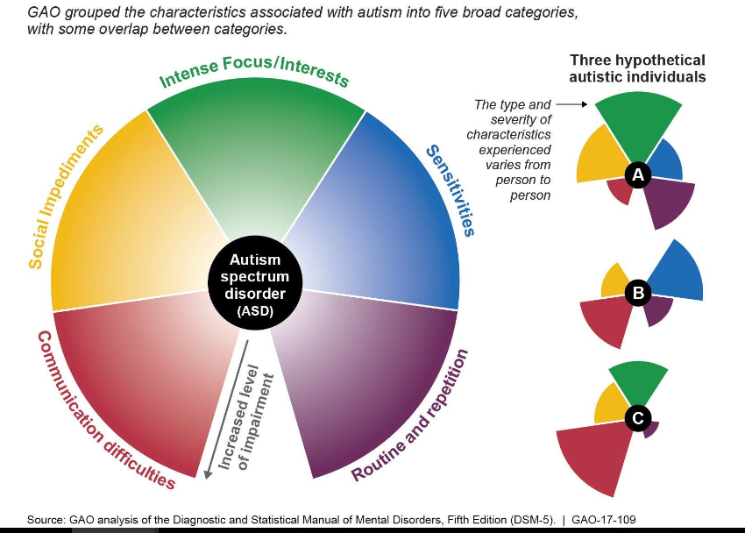
Notes:
https://ec.europa.eu/home-affairs/sites/homeaffairs/files/what-we-do/networks/radicalisation_awareness_network/about-ran/ran-h-and-sc/docs/ran_h-sc_understanding_the_mental_health_190313_25_en.pdf

Slide 4
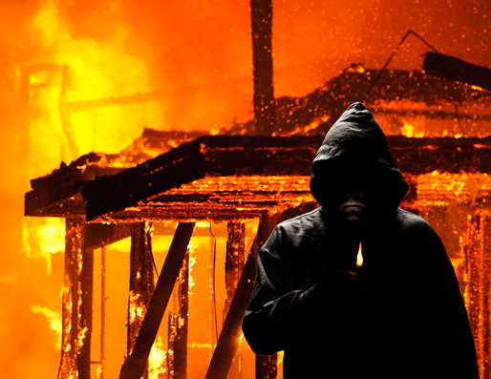
Characteristics of Offences
More common
Among High functioning:
Threats to kill
Arson
Sexual offending
Criminal damage
Stalking
Bowler and Worley (1994), Murrie et al (2002), O’ Brien and Bell (2004), Barry-Walsh & Mullen (2004), Berney (2004), Woodbury-Smith et al (2005)

Slide 5
Risk Factors and Vulnerabilities
A range of reviews (e.g., Gomez de la Cuesta, 2010, Im, 2016; Lerner et al., 2012) suggest that most individuals with an ASD who offend do so because of a combination of reasons.
Typically, these reasons are linked to personal circumstances, such as dealing with periods of transition or change, and the difficulties associated with having an ASD including: social naivety, sensory sensitivities, pursuing a preoccupation, failing to appreciate the consequences of one’s actions, theory of mind difficulties, emotional regulation difficulties, as well as co-morbidity with another psychiatric disorder (e.g., Newman & Ghaziuddin, 2008) (Murphy, 2018).
Alexithymia
Notes:
Alexithymia refers to difficulties in recognising and distinguishing between different emotions and bodily sensations, difficulties in expressing emotions, a lack of imagination or fantasy life, and thoughts focused on external rather than internal experience.
Newman and Ghaziuddin (2008) reviewed all published articles reporting an association of AS with violence.
Of 37 cases that met inclusion criteria, 31 (83.7%) had evidence of a definite or probable psychiatric disorder, including ADHD, depression and other mood disorders, “obsessional neurosis,” & disorders resulting in maximum-security hospitalisation.
Most violent individuals with AS suffer from comorbid psychiatric disorders that raise their risk of offending, as they do in the general population.
Toronto Alexithymia Scale (TAS)
Review demonstrated that up to 50% of autistic people experience co-occurring alexithymia (Kinnaird, Stewart, & Tchanturia, 2019).
Autistic people were found to score higher on the Difficulty Describing Feelings (DDF) and Difficulty Identifying Feelings (DIF) subscales is consistent with research documenting that the difficulties with recognising, identifying and describing emotions characteristic of alexithymia a real so known to be present in ASD. Autistic people are more likely than NT to claim not to feel any emotion, exhibit poorer emotion recognition, have a poorer memory for emotionally significant information, spontaneously mention emotion in conversation, and direct fewer attentional resources towards emotional stimuli (see review Kinnaird, Stewart, & Tchanturia, 2019).

Slide 6
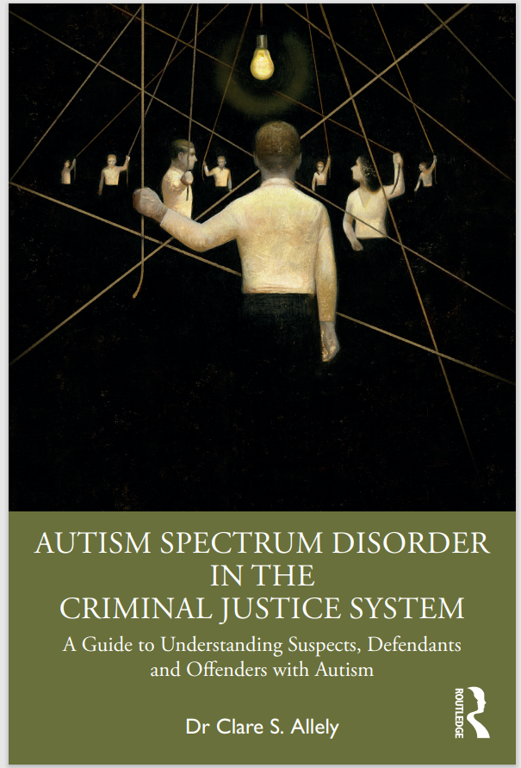
How Certain Features of ASD may Provide the Context of Vulnerability to Engaging in a Number of Types of Offending Behaviours
Arson
Sexual Offences (Offline and Online)
Cybercrime
Violent Offending
Radicalisation and Extremism
Extreme Violence
Stalking

Slide 7
Features of Autism that May Provide the Context of Vulnerability to Engaging in Hands-On Sexual Offending

Slide 8
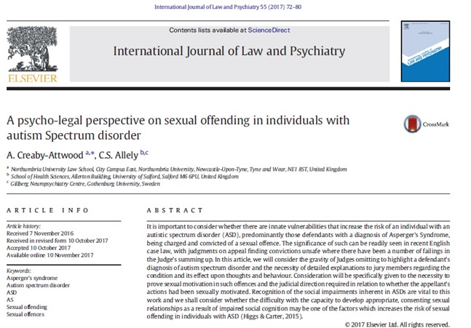
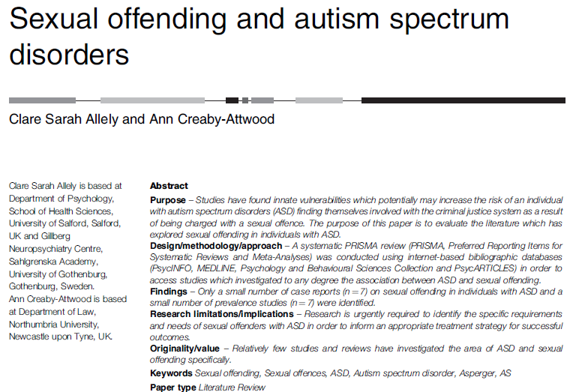
Sexual Offending and Autism
Notes:
Another factor which has been suggested to be contributory to sexual offending in individuals with ASD is the tendency to engage in private sexual behaviours in public places (e.g. masturbating or revealing private body areas) (Van Bourgondien et al., 1997; Kalyva, 2010). This may also result in the sexual exploitation of individuals with ASD (e.g. person(s) may convince an individual with ASD to expose their genitals as a joke in a public place). Sevlever et al. (2013) posit that this kind of sexual offending behaviour comprises the majority of sexual offences related to individuals with ASD.
Individuals with ASD may have difficulty expressing their sexuality within the context of an appropriate relationship due to limited or no experience of being in an intimate relationship which may contribute to offending behaviour due to sexual frustration (Murrie et al., 2002). Other explanations put forward as factors contributing to sexual offending in individuals with ASD are difficulties with impulse control and empathy which results in the individual failing
to appreciate the consequences of their behaviour and act “without thinking” (Haskins and
Silva, 2006). It has also been suggested that the “obsessional” interest often found in individuals
with ASD can lead to offending behaviour if the obsessional interest has a sexual component or
is perceived by the individuals as being sexually related (Murrie et al., 2002; Haskins and Silva,
2006). Related to this, compared to individuals without ASD, individuals with ASD may be more
likely to engage in stalking behaviour (e.g. monitoring the movements of the target of their
affection). Therefore, some studies have indicated that individuals with ASD engage more often
in attempts to interact with a romantic interest despite there being no evidence of reciprocation
from the target to their affections/interests (Stokes et al., 2007). Such behaviours are increasing
the chances of the individuals with ASD being in contact with the criminal justice system. Here
again, social naiveté appears to underlie the stalking behaviour in some individuals with ASD
(Sevlever et al., 2013)

Slide 9
Features of ASD which can Contribute to Sexual Offending Behavior
Allely and Creaby-Attwood (2016) identified a modest number of studies which discussed some of the features of ASD which can contribute to sexual offending behaviour. Some examples of these key features include:
An “obsession or preoccupation with certain things (e.g., women’s underwear)
A failure to conform to social conventions, impaired Theory-of-Mind (ToM). ToM refers to the ability to explain and predict the behaviour of other people by discerning mental states including intentions, beliefs, desires, or emotions (Baron-Cohen, Leslie, & Frith, 1985; Gallagher & Frith, 2003; Kana et al., 2015).
Impaired ability to decode language and social gestures and a limited repertoire of appropriate behaviour” (Allely & Creaby-Attwood, 2016, pp. 47).
Impaired ability to appropriately interpret the victim’s negative facial reactions (e.g., expressions of fear and distress) in response to their sexual advances (Freckelton & List, 2009).
Notes:
A few papers have reported cases where an individual with ASD has engaged in a sexual
offence or inappropriate sexual behaviour. Inappropriate behaviours can include anything
from giving a stranger a kiss (Clements and Zarowska, 2000), intruding on the personal
space of an individual that they are infatuated with (Green et al., 2000; Howlin, 1997; Katz and
Zemishlany, 2006), to inappropriate acts of masturbating (e.g. masturbating in a public
place) (Haracopos and Pendersen, 1992; Ray et al., 2004). Some studies have also
reported cases of individuals with ASD who have become sexually violent (Fujikawa et al., 2002;
Kohn et al., 1998; Murrie et al., 2002). However, while some studies indicate that individuals
with ASDs are no more likely to commit violent crime compared to the general population, there
are some studies which have suggested that it is important to recognise that in individuals
with ASD impairments in the social domain coupled with a desire for attachment or sexual
relations may subsequently lead to sexual offending behaviour (Murrie et al., 2002). Increased
understanding of these ASD impairments are important for informing appropriate treatments.
Increased understanding of these issues faced by some individuals with ASD is also crucial if we
are to avoid unjust harsh sentencing (Freckelton, 2013) such as in the case of Jacob Fisher in
Nebraska who received a prison sentence (20-60 months) for stealing underwear from a
neighbour (WOWT News, 2011).

Slide 10

Sexual Offending and ASD:
Case Study
Milton, Duggan, Latham & Tantam (2002)
Case of a Caucasian male in his early thirties with AS. His convictions can be categorised in 3 main types (acquisitive offences, direct sexual assaults & indirect sexual assaults).
Long history of being fascinated with women's genitalia.
Focus of this fascination was the image of a woman being gynaecologically examined by a doctor.
He would pose as a medical researcher and go on telephone ‘chatlines’ to ask the women he spoke to for details of their gynaecological examinations while he frequently masturbated.
Notes:
History of recurrent sexual offences which included sexual touching of young female’s private regions; watching women in public toilets and pretending to be a gynaecologist and interviewing women about their experiences over the phone.
The fourth case study paper by Milton, Duggan, Latham and Tantam (2002) described the case of a Caucasian male in his early thirties with AS (Asperger’s syndrome). His convictions can be categorised in three main types (acquisitive offences, direct sexual assaults and indirect sexual assaults). He had a history of recurrent sexual offences which included sexual touching of young female’s private regions; watching women in public toilets and pretending to be a gynaecologist and interviewing women about their experiences over the phone. He reported that he had a long history of being fascinated with women's genitalia. The main focus of this fascination was the image of a woman being gynaecologically examined by a doctor. He would pose as a medical researcher and go on telephone ‘chatlines’ to ask the women he spoke to for details of their gynaecological examinations while he frequently masturbated. The Multiphasic Sex Inventory (MSI, Nichols & Molinder, 1984) was used to assess this individual’s sexual attitudes and behaviour. Validity scores on this measure indicated that he was providing deliberately inaccurate answers to questions on the scales of sexual deviance and indications that he was minimalising his paraphilic behaviour. There was evidence of the need for sex education and also the presence of cognitive distortions with respect to the accountability of his offending behaviour. In their formulation of this case, Milton and colleagues (2002) explored the combined impact of the individual’s diagnosis of AS, his paraphilic behaviour and the offending behaviour. Based on their formulation, they put forward the possibility that the individual in this case may have not only obtained immediate sexual gratification from his behaviour but also have received pleasure from the perceived power and a sense of mastery that he had with women.

Slide 11
Sexual Offending and ASD:
Case Studies
Haskins & Silva (2006)
Mr B
Case of Mr B, a middle-aged substitute teacher, who was accused of inappropriately touching the shoulder area of a number of adolescent female students at his school.
He was subsequently charged with several counts of child annoyance and was found guilty on two counts and given probation. Mr B. was given a diagnosis of DSM-IV-TR Pervasive Developmental Disorder-Not Otherwise Specified (NOS) and Sexual Abuse of Child.
He did not meet the diagnostic criteria for DSM-IV-TR for any Paraphilia.
Mr B was unable to develop and maintain any friendships or relationships.
He was also impaired in his ability to recognise and understand how his actions might be perceived by the students and others.
In this case the compulsive nature of his touching behaviour was consistent with repetitive and stereotyped behavioural patterns, related to his ASD (Haskins & Silva, 2006).
Notes:
In the sixth case study paper, Haskins and Silva (2006) highlight that although considering the offending behaviour of individuals with high functioning ASD as being linked to an impaired ToM or abnormal repetitive and restricted interests may appear the easiest way to understand the offending, their offending frequently involve impairments in both these areas and varying levels of causation. The authors outline three cases in their paper which highlight this inability to mentalise and the subsequent consequences. The first case involved arson and murder so is not included here. Case 2 describes Mr B who was a middle-aged substitute teacher accused of touching a number of adolescent female students. He was charged with several counts of child annoyance and was found guilty on two counts and given probation. Mr B was reported to have inappropriately touched the shoulder area of numerous adolescent female students. Mr B. received a diagnosis of DSM-IV-TR Pervasive Developmental Disorder-NOS and Sexual Abuse of Child, but did not fulfil the criteria for DSM-IV-TR criteria for any Paraphilia. Mr B was unable to develop friendships or relationships. He also failed to recognise how his actions might be perceived by the students and others. Moreover, the compulsive nature of his touching behaviour is consistent with repetitive and stereotyped behavioural patterns (Haskins & Silva, 2006). Case 3, described by Haskins and Silva (2006), involved the case of Mr C who was a deaf man referred for outpatient psychotherapy primarily because of his display of inappropriate sexual behaviour. Mr C compulsively solicited male strangers for sex contact which caused him to be banned from some public places and eventually led to an incident where he suffered a physical assault. Mr C, who was white, tended to fixate on and solicit black males and only solicited white males if they had an occupation that interested him. For example, he propositioned a white elevator repair man due to his fascination with elevators and construction sites. In addition to AS, Mr C also had a diagnosis of Dysthymia and Major Depressive Disorder. Mr C had a history of impaired social skills, he lacked friends and was unable to maintain a job. Mr C exhibited impaired ToM as he compulsively approached males for sexual contact with no recognition of the potential hostile reaction he might receive from heterosexual males (Haskins & Silva, 2006).

Slide 12
Sexual Offending and ASD:
Case Studies
Haskins & Silva (2006)
Mr C, a deaf man, who was referred for outpatient psychotherapy mainly because of inappropriate sexual behaviour. He would compulsively solicit male strangers for intercourse usually in public toilets – which subsequently led him to be banned from some public places. He was also eventually physically assaulted by a man he solicited.
He did not appear to appreciate the possible negative consequences of approaching male strangers for sex – which is consistent with an impaired Theory-of-Mind (ToM).
Mr C, who was white, typically fixated on and solicited black males. White males were only solicited by Mr C if they had an occupation which he was interested in. On one occasion, because of his fascination with elevators and construction sites he solicited a white elevator repair man.
Mr C also enjoyed measuring elevators and visiting computer labs that were located on the university grounds. Despite receiving a number of warnings from the University police telling him he was not a student at the University and needed to stop trespassing. He still continued to trespass even though he had been given two charges of trespassing. He would also regularly trespass on construction sites.

Slide 13
Mr C Cont’d
Mr C had a diagnosis of Asperger’s syndrome (AS) co-morbid with dysthymia and major depressive disorder. He had no friends, exhibited impaired social skills and he found it difficult to follow directions on his job. Mr C’s recurrent and indiscriminate soliciting of sex from uninterested males demonstrates his impaired ability to appreciate that heterosexual males may be offended and/or react violently. He did not appear to appreciate or understand the illegal nature of his soliciting behaviour (Haskins & Silva, 2006).
Mr C’s understanding of normal social interactions was significantly distorted. He would frequently complain that “no one came to my house this weekend” even though he had not invited anyone to come round and he did not know anyone who would be likely to visit him unannounced.
During role plays about how to meet new people and how to make friends, in less than three exchanges he would typically go from “Hello. How are you?” to “Will you move in with me?”. He had impaired communication skills. He exhibited very loosely organised conversational skills and both hearing and deaf people found it difficult to understand him. He would not provide his listener with sufficient background information on the topic to enable them to understand him.
There were a number of odd non-verbal behaviours displayed by Mr C. One example of this was the fixed smile on his face irrespective of the topic of discussion during the initial interview. His gait was also awkward.

Slide 14
Case Study
(Murrie et al., 2002)
CD, a 27 year-old male, who was referred for evaluation after a sexual offense which involved a teenage male. He said that there were numerous times where he was exploited when trying to make attempts at sexual contact with someone.
When he was evaluated, CD had a previous diagnosis of Asperger’s which was based on both his adult functioning and early history. Significant social impairments and impairments in nonverbal communication were noted in his mental health records from his adulthood. He graduated from high school with a mediocre academic record and for several years he was a fast-food worker and had limited customer contact.
CD described a history of compulsive masturbation. Specifically, he reported that he masturbated five times daily since he was 10 years old. He also had a collection of “artificial vaginas”. Some of the “artificial vaginas” were commercial and other were home-made products.
He eventually moved out of his family’s home when his sexual preoccupation reached particularly intense levels. He moved into his own residence which was in a government-subsidized apartment so that he could more easily pursue sexual contact.
Notes:
He also had a collection of “artificial vaginas”. Some of the “artificial vaginas” were commercial and other were home-made products. He eventually moved out of his family’s home when his sexual preoccupation reached particularly intense levels. He moved into his own residence which was in a government-subsidized apartment so that he could more easily pursue sexual contact. Despite his intense preoccupation with engaging in sexual intercourse, he typically exhibited a passive and naïve approach in trying to find a partner. CD briefly described his courtship strategy as “hanging around” a woman “until sex happened.” CD had a tendency to be exploited or used during his attempts to seek sexual contact (both those that led to intercourse and those that did not). One example of this was when he would regularly take women from his housing project shopping for lingerie as he believed that such an act could lead to sexual contact. However, once the purchases had been made the women would not stay around. He also hoped he would receive sexual favours when he allowed his home phone to be used by a group of women to arrange illegal drug transactions, even though this had never been suggested by any parties. He also reported women stealing from him (money and possessions), and in one case severely beating him, in his attempts to make sexual contact. The interactions that CD had with males (e.g., meeting men in public parks) resulted more frequently in sexual contact (Murrie et al., 2002).
CD was also a target for sexually-oriented pranks by his neighbours as a result of his hypersexuality and social naiveté. On example of one of these pranks involved a number of men who persuaded CD to engage in intercourse with an inflatable doll and also perform bizarre sexual acts for a group. CD said that he did not gain any enjoyment from “making a spectacle” of himself. However, he did so thinking that it would arouse some of the women leading to sexual contact. CD first became involved with the criminal justice system and evaluation took place after he had repeated sexual contact over several days with a 15-year-old male. CD first met the young man in their apartment complex laundromat. The young man subsequently stayed at CD’s home as he said that he did not have any place to live. CD purchased a number of gifts for the young man (as well as giving him money) and had an active sexual relationship with him over several days. The contact stopped after CD said he would not give the young man any more money. When the youth left CD’s home, he took CD’s stereo with him. CD was arrested for sexual assault against a minor when he went to the police station in order to report the theft of his stereo by the youth.

Slide 15
CD Cont’d
Despite his intense preoccupation with engaging in sexual intercourse, he typically exhibited a passive and naïve approach in trying to find a partner.
CD briefly described his courtship strategy as “hanging around” a woman “until sex happened.”
CD had a tendency to be exploited or used during his attempts to seek sexual contact (both those that led to intercourse and those that did not). One example of this was when he would regularly take women from his housing project shopping for lingerie as he believed that such an act could lead to sexual contact. However, once the purchases had been made the women would not stay around.
He also hoped he would receive sexual favours when he allowed his home phone to be used by a group of women to arrange illegal drug transactions, even though this had never been suggested by any parties.
He also reported women stealing from him (money and possessions), and in one case severely beating him, in his attempts to make sexual contact. The interactions that CD had with males (e.g., meeting men in public parks) resulted more frequently in sexual contact (Murrie et al., 2002).

Slide 16
CD Cont’d
CD was also a target for sexually-oriented pranks by his neighbours as a result of his hypersexuality and social naiveté. On example of one of these pranks involved a number of men who persuaded CD to engage in intercourse with an inflatable doll and also perform bizarre sexual acts for a group. CD said that he did not gain any enjoyment from “making a spectacle”. However, he did so thinking that it would arouse some of the women leading to sexual contact.
CD first became involved with the criminal justice system and evaluation took place after he had repeated sexual contact overall several days with a 15-year-old male. CD first met the young man in their apartment complex laundromat. The young man subsequently stayed at CD’s home as he said that he did not have any place to live. CD purchased a number of gifts for the young man (as well as giving him money) and had an active sexual relationship with him over several days. The contact stopped after CD said he would not give the young man any more money. When the youth left CD’s home, he took CD’s stereo with him. CD was arrested for sexual assault against a minor when he went to the police station in order to report the theft of his stereo by the youth.
It was suggested by Murrie and colleagues (2002) that CD’s likelihood of engaging in sexual offending behaviours was increased due to his sexual naiveté and his impaired understanding of social situations.
Notes:
Findings from a previous evaluation found that CD performed in the average range on verbal tasks and on performance tasks he was found to be in the borderline to mentally impaired range. His scores on the Minnesota Multiphasic Personality Inventory–2 (MMPI-2) were not found to be at clinically elevated levels (they were subthreshold). CD had also undergone testing using penile plethysmography (measurement of bloodflow to the penis, typically used as a proxy for measurement of sexual arousal) following his current offense. Findings from this suggested that he had a primary arousal to consensual contact with adult males. There was indication of arousal to the sexual coercion of children which was less pronounced.

Slide 17

Case Study
(Chesterman & Rutter, 1993)
RM, a 22-year-old male with ASD who was found guilty of several counts of theft and criminal damage. He would steal cotton lingerie from washing lines and stole similar items from other people’s linen baskets in their homes.
On some occasions he would watch clothes spinning round in a front-loading washing machine while he engaged in masturbation with these stolen items. He was charged with the assault of the interviewing police officer during this assessment when they made the suggestion to RM that he had intended to commit burglary. From his point of view, his only intention had been to use the homeowner’s washing machine.
RM was given a three-year probation order with a condition of psychiatric treatment.
This case highlights how the sexual preoccupations of individuals with ASD can provide the context of vulnerability to engaging in offending behaviour.

Slide 18
Case Study
(Dozier et al., 2011)
Case was described by Dozier and colleagues (2011) of Alex, a 36-year old man with ASD and also very poor expressive language ability, who had a 20-year history of inappropriate sexual (masturbatory) behaviour (ISB).
Specifically, he would drop into a prone position close to another person’s feet and then he would gyrate his pelvis on the floor. Alex was excluded from most community facilities (e.g., shopping malls, restaurants, movie theatres) as a result of this behaviour. He was also assigned one-to-one staff supervision.
Dozier and colleagues carried out functional analysis and it was identified that Alex would engage in bizarre sexual behaviour when there was a woman or women around him who wore sandals.

Slide 19
Case Study
(Murrie et al., 2002)
Murrie and colleagues (2002) describe the case of IJ, a 22-year-old male, who was referred for treatment after being suspended from a Scandinavian university after sexually assaultive behaviour. He was given probation.
In the supply closet in university fitness centre, he had made a number of small holes so he could watch girls in the women’s locker room.
When asked what motivated his actions, he denied there being any sexual component. He repeatedly associated his actions to difficulties he was experiencing on one of his courses, feelings of isolation from his peers and failure to communicate with girls even though he had an interest in them. Eventually, downloading online pornography became his main sexual outlet.
IJ would not make eye contact, spoke in a monotonous tone of voice that was not easy for others to hear and he appeared to not have the ability to pace himself to the tempo of the conversation of the people around him.

Slide 20
Cont’d Case Study
(Murrie et al., 2002)
When he was feeling particular anxious and depressed (which was how he was feeling around the time of his offence) he exhibited an unusual manner of speaking. For instance, his speech patterns were sparse and he would often miss out connective phrases.
Although they were odd, he often displayed insightful perceptions and interesting ideas. At some points he could appear to be paranoid or narcissistic, in that in the majority of interactions that he had, he would consider them to be interactions where someone would win and the other would lose.
The ultimate goal of every encounter would be to force one’s will on the other person in a subtle way. He displayed an inability to express his feeling during therapy.
IJ was also awkward physically and self-conscious. He appeared to be impaired in his ability to focus on the emotional meaning of events or experiences. He was unable to develop any understanding of the impact of his actions on the women in the locker room and how they would feel about what he had done. Instead, he would perseverate on the testimonies of the women and the inconsistencies and very minor inaccuracies.

Slide 21
The Features of Autism that May Provide the Context of Vulnerability to Engaging in Indecent Child Imagery or Child Sexual Abuse Images (CSAM)

Slide 22
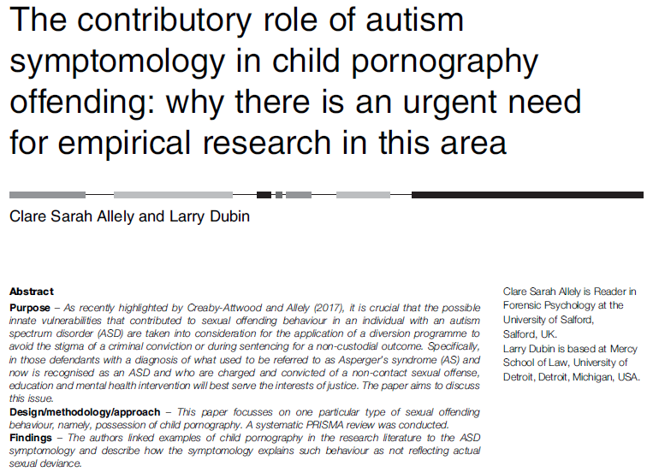
Notes:
One of the primary aims of this paper is to highlight the need to understand and recognise the importance of considering the potential contribution of ASD symptomology in individuals who have been identified as engaging in viewing child pornography.
By doing this, we also highlight the real need for empirical research investigating this.
Currently, there are no empirical studies, only the anecdotal reports and the expertise and knowledge of a relatively small number of professionals whom we have quoted and referred to in this article. These individuals are highly respected in the field (e.g. GaryMesibov, Melissa Sreckovic, KennethM.Mogill, Dennis P. Sugrue).
In this review, we highlight some of the current issues in this area (e.g. issues surrounding appropriate risk assessment in cases involving individuals with ASD who are charged or convicted of possession of child pornography) based on the relatively little work that exists that is predominantly the expert opinions and experience of internationally very well respected and recognised clinicians in the field.
6 internet-based bibliographic databases.
The search followed PRISMA guidelines (see Liberati et al., 2009; Moher et al., 2009).
(ASD or “autis* spectrum disorder*” or autis* or “autis* spectrum condition*” or asperger*). M
_titl. AND (“child pornography” or “online child related sex offend*” or “online child pornography” or “online child pornography offend*” or “online child sexual exploitation” or “internet child abuse” or “online child sex offend*”). m_titl.
Only one article was returned from this search on the databases (Steel, 2016), and this paper was a review, not an empirical study paper.
All the papers or books identified are included in this review paper. The main source included a recently published book on the topic (Caught in the Web of the Criminal Justice System: Autism, Developmental Disabilities, and Sex Offenses, 2017).
A number of chapters in this book were reviewed for relevant material and integrated in the present review (most notably chapters by: Mesibov and Sreckovic; Sugrue; Mogill; Douard, and Schultz).

Slide 23
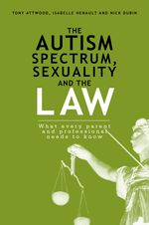

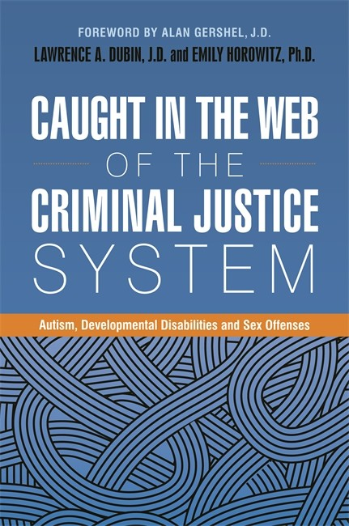
Autism and IIOC
Case of Nick Dubin
Notes:
https://www.youtube.com/watch?v=ItYEpsx6f68
http://www.thedailybeast.com/articles/2013/08/05/autism-and-child-pornography-a-toxic-combination.html

Slide 24
Features of ASD which May Provide the Context of Vulnerability to Engaging in IIOC
Many adolescents and adults with ASD turn to the internet for information and for a sexual outlet.
“Counterfeit deviance”
Unbridled curiosity
ASD individuals’ inability to intuit social mores and legal rules
Empathic deficits (but note that individuals with ASD do have empathy when told that the children in the images are victims and are in distress, etc.)
Social Maturity
Emotional Incongruence
Literal Thinking
Impaired Theory-of-Mind (ToM)
Impaired Ability to Correctly Guess Age
Distinction between of-age and underage females is intentionally blurred by the media and pop culture and legal “adult” porn.
Impaired Ability to Recognise Negative Facial Expressions in IIOC
Notes:
Many individuals with ASD will have average or above average intelligence while their social maturity is that of someone much younger. This frequently results in them being more interested in befriending people who are much younger than themselves but who are socially and emotionally at the same level (Cutler, 2013).
Regarding the viewing of child pornography, issues occur when individuals with ASD are unaware that what they have done is a criminal offense. One explanation for the lack of awareness that they have committed a crime is their inability to recognise the facial expressions in the images of the children.
Such an inability to recognise facial expressions (such as fear) is supported by a large amount of studies (e.g. Woodbury-Smith et al., 2005; Uljarevic & Hamilton, 2013).
Unaware of the broader issues like where and how they got those files, who else might be able to access them and what the consequences (and impact on) are for the minors in the images they are viewing.
Because of their literal view of the world, they would not consider that something that is illegal could be so freely available on the internet.
Media fraught with marketing materials with risky images of teenage models or images where they have made the older models look “barely legal”. Such images can be confusing for the individual with ASD, making it more difficult to determine what is illegal pornography (Mesibov & Sreckovic, 2017).
Distinction between of-age and underage females is intentionally blurred by the media and pop culture and legal “adult” porn (Mahoney, 2009).

Slide 25

Many adolescents and adults with ASD turn to the internet for information and for a sexual outlet (“preferred conduit to the outside world”).
May explore the internet for sexual education or to satisfy sexual needs due to a lack of sexual outlets with peers/friends (Dubin et al., 2014).
When considering ASD and sexuality, “we are often talking about people with strong sexual impulses, little or no information about healthy sexual behavior, and few suitable outlets for sexual gratification” (Sugrue, 2017, p. 177).
Given this, many adolescents and adults with ASD turn to the internet for information and for a sexual outlet. The internet becomes the ideal solution because it has already established itself as being their “preferred conduit to the outside world” (Sugrue, 2017, p. 117).

Slide 26
“Counterfeit deviance”
Hingsburger, Griffiths and Quinsey (1991) coined the term ‘counterfeit deviance’. The was coined to describe people with intellectual disability who appeared to have paraphilia but, in fact, did not.
‘It is not a clinical disorder but a concept which suggests that sexually inappropriate, and sometimes criminal sexual behaviours, in individuals with ASD can be influenced by a wide range of both internal factors and factors concerning a person’s external environment.
An attorney who has defended many ASD males on charges of possession of child pornography incorporates the concept of “counterfeit deviance” in understanding what might seem like acts of deviance but the individual “but lacks the culpable mental state or blameworthiness which would normally attend such actions by persons who are typically developed” (Mahoney, 2017).
The viewing of sexual material which is extreme is not always a reflection of the presence of deviant sexuality - behaviours could masquerade as paraphilia/sexually deviant behaviour but lack the underlying urges.
Notes:
https://www.redwoodcoastrc.org/sites/default/files/u2/CounterfeitDevianceRevisted.pdf

Slide 27
Case Example of Counterfeit Deviance:
Joe
Sexually inappropriate behaviors and their precursors often first occur within an educational environment. Many inappropriate sexual behaviors that occur in school are addressed and managed through a behavioral support plan created by school personnel, typically without input from law enforcement. However, once a person leaves the education system, the same behaviors that were addressed in school may result in criminal charges.
There is rarely a transition or step-down period to help young adults adjust to such a change. For instance, consider the following case example:
Joe, a 17-year old student, exposed his penis to his teaching assistant in high school. The education team conducted a functional behavior assessment. Results suggested that Joe exposed his penis in order to escape work demands. Thus, Joe’s behavior plan dictated that each time he exposed himself, school staff would ignore the behavior and redirect him back to work. With the plan in place, his behavior reduced substantially. However, when Joe started an internship in an employment setting and was faced with new demands, the behavior resurfaced. Joe exposed himself to his supervisor. He lost his job, the supervisor filed a police report, and criminal charges were brought against him.
It is clear that the school team thought they were doing the right thing by providing a function-based behavior plan. However, the plan failed to consider Joe’s presentation as an adult in the community
(Loftin, 2021).

Slide 28
Case Example of Counterfeit Deviance:
Joe
In the example of Joe’s pattern of sexual behavior, he exposed his penis in order to escape work demands. Through trial and error, Joe learned that exposing his genitals caused a halt in the demands in his environment, which reinforced the exposing behavior. Ordinarily, one would assume that exposing genitals was a sexual activity, undertaken to derive sexual pleasure, and the supervisor who fired Joe made this assumption.
Misperception of intention, in which a person’s motivations are perceived as sexual when they are not, is known as “counterfeit deviance”. The observed behavior served a function that was unrelated to sexual urges or fantasies.
The term has been used in ASD work, although there are no studies of counterfeit deviance using autistic samples. Still, there are anecdotal cases in which an autistic person’s behavior is attributed to sexual reasons when, in fact, their behavior services a nonsexual purpose, such as fulfillment of a compulsive routine or pursuit of a sensory interest.
It is a complicated issue, however, because behaviors can be multiply determined. That is, it is possible that Joe used the behavior to escape work demands and simultaneously experienced sexual excitement from exposing himself.
(Loftin, 2021).

Slide 29

Unbridled Curiosity
Their curiosity, unrestrained by social or legal taboos, of which they are unaware, leads them to view images of “underage” (i.e. younger than 18-years old) girls who are nearly their own age and years older than the level of their own social adaptation skills.

Slide 30

ASD individuals’ inability to intuit social mores and legal rules
Given the experiences of many individuals with ASD, the values held in society regarding sexuality may have never been learned.
The individual may not have developed standards on which to judge their own behaviour or that of others.

Slide 31
Empathic Deficits
It is a commonly held misconception that individuals with ASD lack empathy.
However, according to the empathy imbalance hypothesis (EIH) of ASD, individuals with ASD are impaired in terms of their cognitive empathy but they have a ‘surfeit’ (heightened capacity) of emotional empathy (Dziobek et al., 2008; Smith, 2009; Trimmer, McDonald, & Rushby, 2017).
Cognitive empathy - ability to understand and predict other people’s behaviour in terms of attributed mental states (e.g., believing, knowing, pretending, and guessing).
Emotional empathy - the ability to emotionally resonate with the feelings of another individual while also being able to appreciate and understand that they are distinct from one’s own feelings (Baron-Cohen & Wheelwright, 2004).

Slide 32
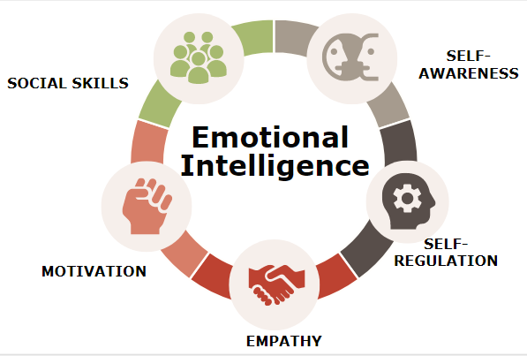
Social Maturity
Some individuals with ASD may gravitate towards and feel more comfortable with individuals who are the same level as them in terms of social maturity.
Many individuals with ASD have an average or above average intelligence while their social maturity can be comparable to that of someone much younger which often leads them to be more interested and comfortable in befriending people who are much younger than them (they are at the same level as them socially and emotionally) (Cutler, 2013).

Slide 33
Emotional Congruence
Whether and how the concept of emotional congruence is applicable to those with ASD is unknown. However, a strong interest in games or activities that are typical of a much younger person is exceedingly common among those with autism. For instance, it is not atypical for an adolescent to enjoy young children’s television programs or for an adult to pursue an interest that is more typical of children, such as collecting Pokémon cards.
Despite the normalcy of immature interests among autistic adults, the combination of a childish interest with the desire to form friendships and a lack of appreciation of social rules guiding adult contact with children may place both the child and the autistic adult at risk.
Although it has not been specifically established as a risk factor for offending among people with ASD, emotional congruence with children is a common consideration during sexual risk assessments.
If an evaluator is not familiar with autism and the tendency for autistic people to pursue interests that typically appeal to a younger age group, they may misperceive an interest in childish topics as a risk factor.

Slide 34

Literal Thinking
Because of their literal view of the world, they would not consider that something that is illegal could be so freely available on the internet.

Slide 35
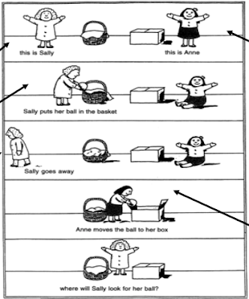
Impaired Theory-of-Mind (ToM)
Unaware of the broader issues of the images/videos including:
where and how they got those files
who else might be able to access them
what the consequences (and impact on) are for the minors in the images they are viewing.

Slide 36


Nick has also discussed how he was not aware of the broader context of the images and how they were created:
“At the time, I didn’t understand that downloading free images on my computer in the privacy of my residence could lead to the severe legal consequences I later experienced. I also didn’t understand at the time that the children in the images had been victimized in the process of creating those images. I honestly had no idea that I was causing harm to anyone. It is very embarrassing to admit that I needed to have this information spelled out for me, as I wasn’t able to make that connection on my own. After my arrest, [my psychologist] spent considerable time explaining the issue of victim awareness to me. I was horrified to learn that these minors had been mistreated and that I had not been able to see that.” (Dubin, Hénault, & Attwood, 2014, pp. 99).

Slide 37

Impaired Ability to Correctly Guess Age

Slide 38

Distinction between of-age and underage females is intentionally blurred by the media and pop culture and legal “adult” porn
Media fraught with marketing materials with risky images of teenage models or images where they have made the older models look “barely legal”.
Such images can be confusing for the individual with ASD, making it more difficult to determine what is illegal pornography (Mesibov & Sreckovic, 2017).
Distinction between of-age and underage females is intentionally blurred by the media and pop culture and legal “adult” porn (Mahoney, 2009).

Slide 39

Notes:
Numerous cases where the individual with ASD has been found to have large collections of pornographic material (e.g. involving children) (as part of the ritualistic nature of ASD) with thousands of files not even opened.
As with many things that interest them, the desire for this material can end up being particularly excessive and compulsive in individuals with ASD (Mesibov & Sreckovic, 2017).
There is an assumption that the level of risk is associated with the number of images that the individual has accumulated or the nature of the content. This is because it is believed by some that the more images, the greater the obsession, and they are more at risk of acting on these urges as a result (Sugrue, 2017). However, studies do not support this (Stabenow, 2011).
They do not take into consideration the relationship between the volume of collected pornography and the compulsive and obsessive features of ASD.
Looking at extreme sexual material is not always a reflection of the presence of deviant sexuality. No research which indicates that extreme sexual content is predictive of dangerousness (Osborn et al., 2010). It can be what is referred to as “counterfeit deviance” (e.g. naïve curiosity) in individuals with ASD Their curiosity, unrestrained by social or legal taboos, of which they are unaware, leads them to view images of “underage” (i.e. younger than 18-years old) girls who are nearly their own age and years older than the level of their own social adaptation skills (Mahoney, 2009, p. 1).
Sex offender risk assessments are crucial for informing appropriate and effective strategies for individual offender management (e.g. community management) (Grubin, 2008).
These risk assessments have not been normed for individuals with ASD. They also have not been normed for people whose only offense is viewing child pornography (Sugrue, 2017).
Forces clinicians to rely on published literature which is limited in relation to ASD and child pornography in particular. Research based on neurotypicals frequently has to be extrapolated based on clinicians’ and other health professionals’ knowledge and understanding of ASD (Sugrue, 2017).

Slide 40


Slide 41

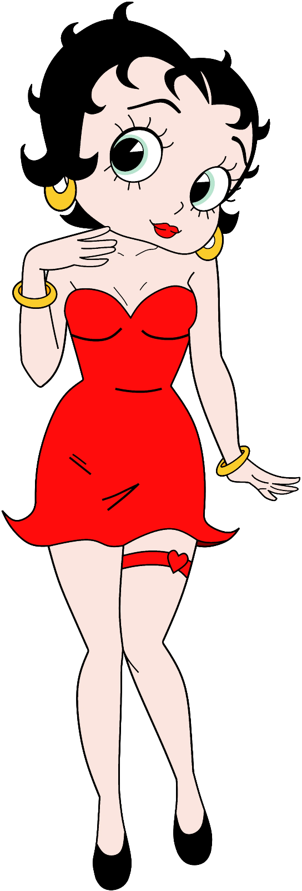
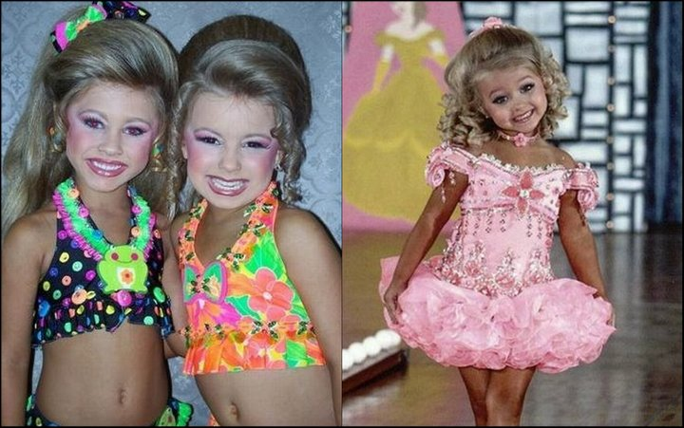

Slide 42
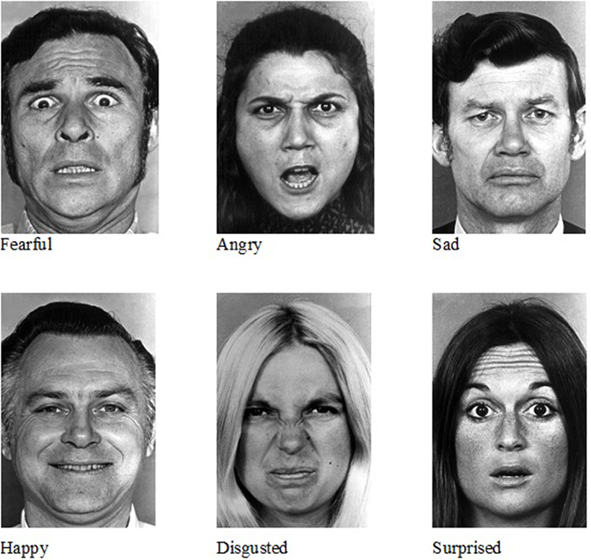
Impaired Ability to Recognise Negative Facial Expressions in IIOC
Regarding the viewing of child pornography, issues occur when individuals with ASD are unaware that what they have done is a criminal offense.
One explanation for the lack of awareness that they have committed a crime is their inability to recognise the facial expressions in the images of the children.
Such an inability to recognise facial expressions (such as fear) is supported by a large amount of studies (e.g. Woodbury-Smith et al., 2005; Uljarevic & Hamilton, 2013).

Slide 43
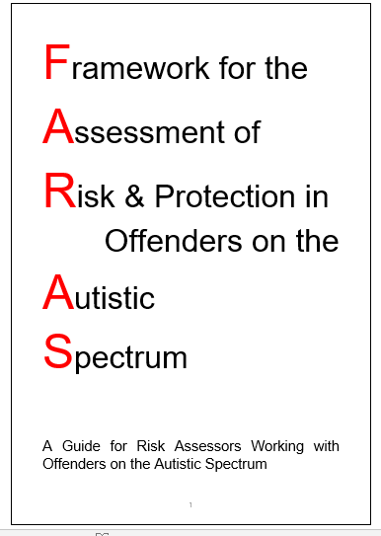
FARAS
Should be used by as an adjunct to risk assessments.
Reference: Al-Attar, Z. (2018).
Notes:
It should only be used by as an adjunct to risk/threat assessments and not as a threat assessment. If you can impress this please that would be great. The reference for FARAS is Al-Attar (2018)

Slide 44
FARAS
Most risk assessment tools do not focus on the ‘function’ of risk behaviours (i.e. why the individual engages in them and what needs they meet for that individual).
Therefore, even if they capture behaviours exhibited by offenders with ASD, they do not distinguish why this behaviour is carried out. Thus, the depth of formulations and their utility to inform rehabilitation will be limited.
The FARAS guidelines address how to delineate the autistic functions of behaviour and hence may add depth and specificity to standard risk assessments as well as help inform rehabilitation pathways for offenders on the autistic spectrum.

Slide 45


How Certain Features of Autism Spectrum Disorder May Provide the Context of Vulnerability to Involvement with Online Extremist Groups, Being Radicalised and Engaging in Terroristic Behaviours

Slide 46
Dr Zainab Al-Attar (2020) outlined and examined seven facets of ASD that may have different functional links with push and pull factors to terrorism (or extremist behaviour/offending).
Facet 1: Circumscribed interests
Facet 2: Rich vivid fantasy & impaired social imagination
Facet 3: Need for order, rules, rituals, routine and predictability
Facet 4: Obsessionality, repetition and collecting
Facet 5: Social interaction and communication difficulties
Facet 6: Cognitive styles
Facet 7: Sensory processing
Notes:
Al-Attar, Z. (2020). Autism spectrum disorders and terrorism: How different features of autism can contextualise vulnerability and resilience. The Journal of Forensic Psychiatry and Psychology, 31(6), 926-949.
Al-Attar, Z. (2018). Interviewing Terrorism Suspects and Offenders with an Autism Spectrum Disorder. International Journal of Forensic Mental Health, 17(4), 321-337.

Slide 47
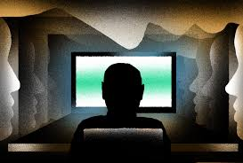
Facet 1: Circumscribed interests
One of the core features of ASD is an intense, narrow, all absorbing interest that may become pre-occupying and frequently researched in extensive detail by the individual.
Circumscribed interests may offer a sense of purpose, social identity and topic of conversation, and the autistic individual often finds that they function at their optimal levels of cognitive, motivational, and social functioning and present with a high level of expertise when engaging and conversing in the topic of their interest.
When researching their all-consuming and obsessional interest, they may become completely immersed and absorbed in their details and the immediate rewards becoming less focused on the links in the cause-and-effect of their behaviour (Al-Attar, 2019).
Notes:
Sharing of interests may become the most natural and comfortable vehicle for establishing and maintaining social relationships
Terrorism and other types of high-profile crimes are very salient events. Unsurprising then that restricted interests in these things may develop (Al-Attar, 2020).
Al-Attar, Z. (2016a, April 19–20). Autism & terrorism links – Fact or fiction? 15th international conference on the care and treatment of offenders with an intellectual and/or developmental disability. Manchester: National Autistic Society.
Al-Attar, Z. (2016b, September 16–18). Autism & terrorism links – Baseless headlines or clinical reality? XI autism-Europe international congress. Edinburgh: Autism-Europe & National Autistic Society.
Al-Attar, Z. (2018). Interviewing Terrorism Suspects and Offenders with an Autism Spectrum Disorder. International Journal of Forensic Mental Health, 17(4), 321-337.
Al-Attar, Z. (2018a). Development and evaluation of guidance to aid risk assessments of offenders with autism [Unpublished MA Dissertation]. Sheffield Hallam University.
Al-Attar, Z. (2018b). Interviewing terrorism suspects and offenders with an autism spectrum disorder. International Journal of Forensic Mental Health, 17(4), 321–337.
Al-Attar, Z. (2018c, March 7–8). Terrorism and autism – Making sense of the links in formulations of risk and protective factors. The autism professionals annual conference 2018, Harrogate.
Al-Attar, Z. (2019). 2019 Handbook Radicalisation Awareness Network (RAN) Health and Social Care subgroup. Extremism, Radicalisation and Mental Health: Handbook for Practitioners. Available from: https://ec.europa.eu/home-affairs/sites/default/files/what-we-do/networks/radicalisation_awareness_network/about-ran/ran-h-and-sc/docs/ran_h-sc_handbook-for-practitioners_extremism-radicalisation-mental-health_112019_en.pdf Accessed on 21st July 2021.
Al-Attar, Z. (2020). Autism spectrum disorders and terrorism: How different features of autism can contextualise vulnerability and resilience. The Journal of Forensic Psychiatry and Psychology, 31(6), 926-949.
Allely, C. S., & Faccini, L. (2018). Rare instances of individuals with autism supporting or engaging in terrorism: a reply. Journal of Intellectual Disabilities and Offending Behaviour, 9(1), 64-66.

Slide 48

Facet 2: Rich vivid fantasy and impaired social imagination
Restricted interests and pre-occupations may be exhibited through vivid fantasy which is usually visual (Al-Attar, 2020).
The contents of their fantasy life are usually based, very directly, on what they have come across both offline and online as opposed to being based on social imagination or abstract ideas (Al-Attar, 2019).
The fine details of the fantasy may be more captivating than any wider emotional meaning or social context of the fantasy and when these are shared online or offline by the individual and affirmed by others, fantasy can become socially/externally reinforced also.
In the fantasies there may be certain themes which provide ‘certain functions’ (e.g., revenge or violent fantasies which alleviate feelings of anger) or ‘general functions’ (e.g., being intellectually stimulating or exciting) (Al-Attar, 2020).
Notes:
Fantasy can be powerful and drive behaviour in some individuals with ASD (Palermo & Bogaerts, 2015), so interviewers also need to recognise the role that fantasy can have and not dismiss it as mere wishful thinking (Al-Attar, 2018b).
Al-Attar, Z. (2016a, April 19–20). Autism & terrorism links – Fact or fiction? 15th international conference on the care and treatment of offenders with an intellectual and/or developmental disability. Manchester: National Autistic Society.
Al-Attar, Z. (2016b, September 16–18). Autism & terrorism links – Baseless headlines or clinical reality? XI autism-Europe international congress. Edinburgh: Autism-Europe & National Autistic Society.
Al-Attar, Z. (2018). Interviewing Terrorism Suspects and Offenders with an Autism Spectrum Disorder. International Journal of Forensic Mental Health, 17(4), 321-337.
Al-Attar, Z. (2018a). Development and evaluation of guidance to aid risk assessments of offenders with autism [Unpublished MA Dissertation]. Sheffield Hallam University.
Al-Attar, Z. (2018b). Interviewing terrorism suspects and offenders with an autism spectrum disorder. International Journal of Forensic Mental Health, 17(4), 321–337.
Al-Attar, Z. (2018c, March 7–8). Terrorism and autism – Making sense of the links in formulations of risk and protective factors. The autism professionals annual conference 2018, Harrogate.
Al-Attar, Z. (2019). 2019 Handbook Radicalisation Awareness Network (RAN) Health and Social Care subgroup. Extremism, Radicalisation and Mental Health: Handbook for Practitioners. Available from: https://ec.europa.eu/home-affairs/sites/default/files/what-we-do/networks/radicalisation_awareness_network/about-ran/ran-h-and-sc/docs/ran_h-sc_handbook-for-practitioners_extremism-radicalisation-mental-health_112019_en.pdf Accessed on 21st July 2021.
Al-Attar, Z. (2020). Autism spectrum disorders and terrorism: How different features of autism can contextualise vulnerability and resilience. The Journal of Forensic Psychiatry and Psychology, 31(6), 926-949.
Allely, C. S., & Faccini, L. (2018). Rare instances of individuals with autism supporting or engaging in terrorism: a reply. Journal of Intellectual Disabilities and Offending Behaviour, 9(1), 64-66.

Slide 49
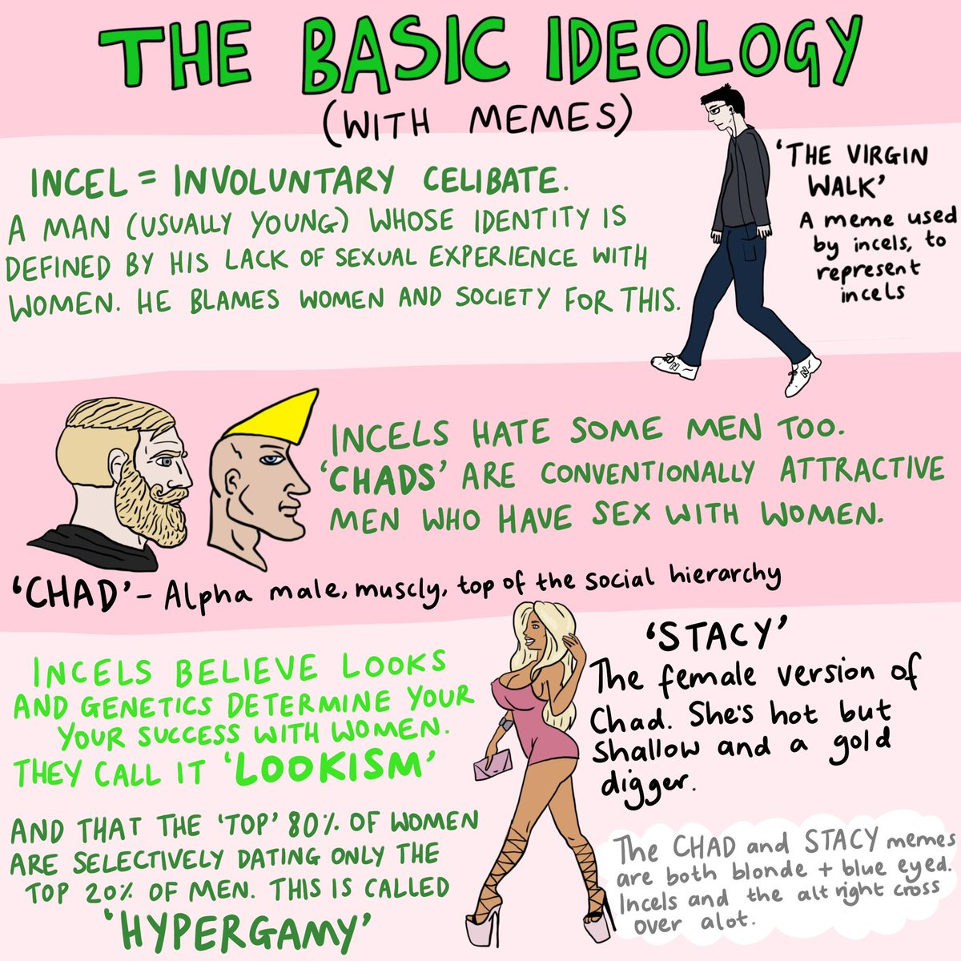
Facet 3: Need for order, rules, rituals, routine and predictability
The social world can be chaotic and unpredictable for some with ASD. They may read and carry out extensive amounts of research to try and made sense of an otherwise chaotic world. May come across, often unintentionally, “explanations” and “solutions” which are extremist. Most extremist ideologies and terrorist groups claim to offer explanations for moral chaos, social injustice as well as solutions for this which are both concrete and literal (Al-Attar, 2018b, 2020).
Extremist groups often brand themselves as organised, systematic and orderly. Some individuals with ASD find the world easier to understand the world when it is explained to them in categories, facts and systems (bypassing the complex social and emotional aspects of people’s lives) (Al-Attar, 2019).
Notes:
The social world can be chaotic and unpredictable for individuals with ASD (Al-Attar, 2020) which can be experienced as intolerable. ‘Real world’ is chaotic, inconsistent and shifting categories of right/wrong and its ‘grey areas’ of social meaning and behaviour
For autistic individuals with high levels of systemizing and low levels of empathizing (Baron-Cohen, 2002), the world (including the social and political world) makes clearer sense and feels more predictable when it is explained in categories, facts and systems, instead of social and emotional theories (AlAttar, 2018a, 2018b, 2019).
Al-Attar, Z. (2016a, April 19–20). Autism & terrorism links – Fact or fiction? 15th international conference on the care and treatment of offenders with an intellectual and/or developmental disability. Manchester: National Autistic Society.
Al-Attar, Z. (2016b, September 16–18). Autism & terrorism links – Baseless headlines or clinical reality? XI autism-Europe international congress. Edinburgh: Autism-Europe & National Autistic Society.
Al-Attar, Z. (2018). Interviewing Terrorism Suspects and Offenders with an Autism Spectrum Disorder. International Journal of Forensic Mental Health, 17(4), 321-337.
Al-Attar, Z. (2018a). Development and evaluation of guidance to aid risk assessments of offenders with autism [Unpublished MA Dissertation]. Sheffield Hallam University.
Al-Attar, Z. (2018b). Interviewing terrorism suspects and offenders with an autism spectrum disorder. International Journal of Forensic Mental Health, 17(4), 321–337.
Al-Attar, Z. (2018c, March 7–8). Terrorism and autism – Making sense of the links in formulations of risk and protective factors. The autism professionals annual conference 2018, Harrogate.
Al-Attar, Z. (2019). 2019 Handbook Radicalisation Awareness Network (RAN) Health and Social Care subgroup. Extremism, Radicalisation and Mental Health: Handbook for Practitioners. Available from: https://ec.europa.eu/home-affairs/sites/default/files/what-we-do/networks/radicalisation_awareness_network/about-ran/ran-h-and-sc/docs/ran_h-sc_handbook-for-practitioners_extremism-radicalisation-mental-health_112019_en.pdf Accessed on 21st July 2021.
Al-Attar, Z. (2020). Autism spectrum disorders and terrorism: How different features of autism can contextualise vulnerability and resilience. The Journal of Forensic Psychiatry and Psychology, 31(6), 926-949.
Allely, C. S., & Faccini, L. (2018). Rare instances of individuals with autism supporting or engaging in terrorism: a reply. Journal of Intellectual Disabilities and Offending Behaviour, 9(1), 64-66.

Slide 50
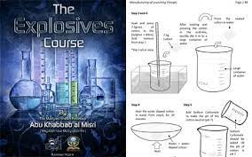
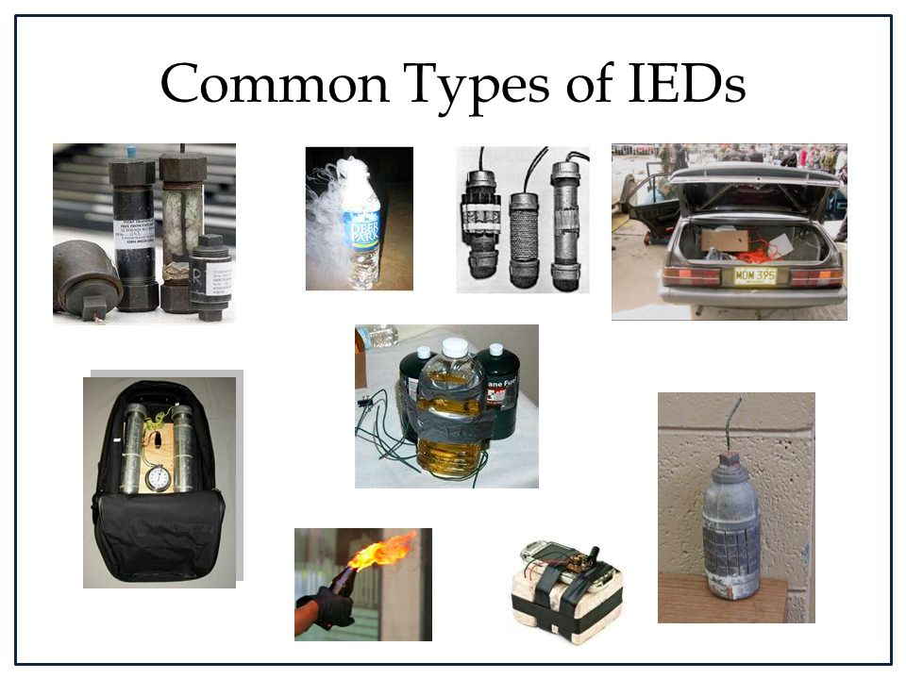
Facet 4: Obsessionality, Repetition & Collecting
It is common for autistic individuals to pursue their interest or pre-occupation in a repetitive manner (and pedantically) and it becomes all-encompassing as they engage in their pre-occupation at the expense of other things such as social relationships (Klin et al., 2007).
With regards to terroristic (or extremist) behaviour, the individual may engage in the accumulation of substantial amounts of information or data associated with terrorism, watch propaganda videos repeatedly or engage in making items relating to terrorism.
Pre-occupational interests may be inaccurately misinterpreted as being strong indication of an intense commitment to terrorism.
Notes:
However, in many cases of autistic individuals, it is more accurate to see this type of behaviour (which is associated with ASD) as “being driven or at least accentuated by obsessionality, repetition, pedantry for detail and compulsive collecting/pursuit, as opposed to evidence of broader or greater ideological objectives or greater operational involvement” (Al-Attar, 2020, pp. 937).
Al-Attar, Z. (2016a, April 19–20). Autism & terrorism links – Fact or fiction? 15th international conference on the care and treatment of offenders with an intellectual and/or developmental disability. Manchester: National Autistic Society.
Al-Attar, Z. (2016b, September 16–18). Autism & terrorism links – Baseless headlines or clinical reality? XI autism-Europe international congress. Edinburgh: Autism-Europe & National Autistic Society.
Al-Attar, Z. (2018). Interviewing Terrorism Suspects and Offenders with an Autism Spectrum Disorder. International Journal of Forensic Mental Health, 17(4), 321-337.
Al-Attar, Z. (2018a). Development and evaluation of guidance to aid risk assessments of offenders with autism [Unpublished MA Dissertation]. Sheffield Hallam University.
Al-Attar, Z. (2018b). Interviewing terrorism suspects and offenders with an autism spectrum disorder. International Journal of Forensic Mental Health, 17(4), 321–337.
Al-Attar, Z. (2018c, March 7–8). Terrorism and autism – Making sense of the links in formulations of risk and protective factors. The autism professionals annual conference 2018, Harrogate.
Al-Attar, Z. (2019). 2019 Handbook Radicalisation Awareness Network (RAN) Health and Social Care subgroup. Extremism, Radicalisation and Mental Health: Handbook for Practitioners. Available from: https://ec.europa.eu/home-affairs/sites/default/files/what-we-do/networks/radicalisation_awareness_network/about-ran/ran-h-and-sc/docs/ran_h-sc_handbook-for-practitioners_extremism-radicalisation-mental-health_112019_en.pdf Accessed on 21st July 2021.
Al-Attar, Z. (2020). Autism spectrum disorders and terrorism: How different features of autism can contextualise vulnerability and resilience. The Journal of Forensic Psychiatry and Psychology, 31(6), 926-949.
Allely, C. S., & Faccini, L. (2018). Rare instances of individuals with autism supporting or engaging in terrorism: a reply. Journal of Intellectual Disabilities and Offending Behaviour, 9(1), 64-66.

Slide 51
Facet 5: Social interaction and communication difficulties
Autistic individuals can find navigating the social world challenging, stressful, anxiety-provoking and exhausting which can lead many to withdraw from the complex social world becoming socially isolated and anxious as a result. The online environment is a predictable and safe environment.
Like-minded individuals can also communicate and share their interests and opinions on the online environment. For some with ASD, this may be the first time they have ever experienced a sense of connection or belonging to another person or group (Al-Attar, 2020).
If the autistic individual accesses extremist websites, they may read what is on these extremist websites and take them literally & at face value (Al-Attar, 2019, pp. 12).
They may talk about their ideology in very graphic, matter of fact terms, with a flat expression and tone of voice and volunteer a substantial amount of detail. Such a presentation may be mistaken by the interviewer as evidence of boasting about terrorist capabilities and impact or trying to cause fear or to shock (Al-Attar, 2018b).
Notes:
Al-Attar, Z. (2016a, April 19–20). Autism & terrorism links – Fact or fiction? 15th international conference on the care and treatment of offenders with an intellectual and/or developmental disability. Manchester: National Autistic Society.
Al-Attar, Z. (2016b, September 16–18). Autism & terrorism links – Baseless headlines or clinical reality? XI autism-Europe international congress. Edinburgh: Autism-Europe & National Autistic Society.
Al-Attar, Z. (2018). Interviewing Terrorism Suspects and Offenders with an Autism Spectrum Disorder. International Journal of Forensic Mental Health, 17(4), 321-337.
Al-Attar, Z. (2018a). Development and evaluation of guidance to aid risk assessments of offenders with autism [Unpublished MA Dissertation]. Sheffield Hallam University.
Al-Attar, Z. (2018b). Interviewing terrorism suspects and offenders with an autism spectrum disorder. International Journal of Forensic Mental Health, 17(4), 321–337.
Al-Attar, Z. (2018c, March 7–8). Terrorism and autism – Making sense of the links in formulations of risk and protective factors. The autism professionals annual conference 2018, Harrogate.
Al-Attar, Z. (2019). 2019 Handbook Radicalisation Awareness Network (RAN) Health and Social Care subgroup. Extremism, Radicalisation and Mental Health: Handbook for Practitioners. Available from: https://ec.europa.eu/home-affairs/sites/default/files/what-we-do/networks/radicalisation_awareness_network/about-ran/ran-h-and-sc/docs/ran_h-sc_handbook-for-practitioners_extremism-radicalisation-mental-health_112019_en.pdf Accessed on 21st July 2021.
Al-Attar, Z. (2020). Autism spectrum disorders and terrorism: How different features of autism can contextualise vulnerability and resilience. The Journal of Forensic Psychiatry and Psychology, 31(6), 926-949.
Allely, C. S., & Faccini, L. (2018). Rare instances of individuals with autism supporting or engaging in terrorism: a reply. Journal of Intellectual Disabilities and Offending Behaviour, 9(1), 64-66.

Slide 52
Facet 6: Cognitive styles
There are four features of neurocognitive functioning which Al-Attar has drawn attention to which may contribute to the push and pull factors (Al-Attar, 2020).
(1) Theory-of-Mind
(2) Central Coherence
(3) Systemising
(4) Attention-switching
“Push” factors may include distress, insecurity, and anxiety which are caused by perceived threats and injustice. “Pull” factors include “the appeal of extremist causes and groups in addressing such negative feelings and restoring order, safety, and justice” (Al-Attar, 2018b, pp. 326).
Notes:
Individuals with ASD can exhibit an impaired attention switching ability which can have a detrimental impact on their mental flexibility and their ability to switch attention between different topics/ideas (Al-Attar, 2020).
This type of neurocognitive functioning may impact the pathway to terrorist offending itself. For instance, when the offence related interests and ideas become fixated and perseverant. For example, setting out to make an explosive which subsequently leads to the research of a range of types of explosive.
Al-Attar, Z. (2016a, April 19–20). Autism & terrorism links – Fact or fiction? 15th international conference on the care and treatment of offenders with an intellectual and/or developmental disability. Manchester: National Autistic Society.
Al-Attar, Z. (2016b, September 16–18). Autism & terrorism links – Baseless headlines or clinical reality? XI autism-Europe international congress. Edinburgh: Autism-Europe & National Autistic Society.
Al-Attar, Z. (2018). Interviewing Terrorism Suspects and Offenders with an Autism Spectrum Disorder. International Journal of Forensic Mental Health, 17(4), 321-337.
Al-Attar, Z. (2018a). Development and evaluation of guidance to aid risk assessments of offenders with autism [Unpublished MA Dissertation]. Sheffield Hallam University.
Al-Attar, Z. (2018b). Interviewing terrorism suspects and offenders with an autism spectrum disorder. International Journal of Forensic Mental Health, 17(4), 321–337.
Al-Attar, Z. (2018c, March 7–8). Terrorism and autism – Making sense of the links in formulations of risk and protective factors. The autism professionals annual conference 2018, Harrogate.
Al-Attar, Z. (2019). 2019 Handbook Radicalisation Awareness Network (RAN) Health and Social Care subgroup. Extremism, Radicalisation and Mental Health: Handbook for Practitioners. Available from: https://ec.europa.eu/home-affairs/sites/default/files/what-we-do/networks/radicalisation_awareness_network/about-ran/ran-h-and-sc/docs/ran_h-sc_handbook-for-practitioners_extremism-radicalisation-mental-health_112019_en.pdf Accessed on 21st July 2021.
Al-Attar, Z. (2020). Autism spectrum disorders and terrorism: How different features of autism can contextualise vulnerability and resilience. The Journal of Forensic Psychiatry and Psychology, 31(6), 926-949.
Allely, C. S., & Faccini, L. (2018). Rare instances of individuals with autism supporting or engaging in terrorism: a reply. Journal of Intellectual Disabilities and Offending Behaviour, 9(1), 64-66.

Slide 53
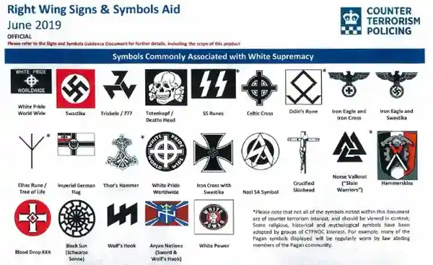
Facet 7: Sensory processing
May be a significant sensory appeal (strong sensory pull) to terrorist materials to some autistic individuals (e.g., their colours, lights, smells, noises of chemicals and explosives). Terrorist imagery, magazines, diagrams, flags, murals, uniforms, weapons and paraphernalia, etc., can have a significant sensory appeal (visually - detail/colour) to the autistic individual (Al-Attar, 2020). Hypersensitivity may have played a contributory role in an indirect way to the offence pathway (Al-Attar, 2018b).
Notes:
Differences in processing sensory information across the range of modalities (sound, sight, touch, smell) is experienced in many autistic individuals.
Hypersensitivity may have played a contributory role in an indirect way to the offence pathway For instance, an individual who takes to the internet and offence websites in order to escape the chaotic, sensory overloading physical world (Al-Attar, 2018b).
Sensory hypersensitivity may lead to negative experiences and reduced positive opportunities which may be a push factor into terrorist involvement or behaviour indirectly if it were to aggravate or exacerbate feelings of grievance, anger as well as feelings of real or perceived injustice (Al-Attar, 2020).
Al-Attar, Z. (2016a, April 19–20). Autism & terrorism links – Fact or fiction? 15th international conference on the care and treatment of offenders with an intellectual and/or developmental disability. Manchester: National Autistic Society.
Al-Attar, Z. (2016b, September 16–18). Autism & terrorism links – Baseless headlines or clinical reality? XI autism-Europe international congress. Edinburgh: Autism-Europe & National Autistic Society.
Al-Attar, Z. (2018). Interviewing Terrorism Suspects and Offenders with an Autism Spectrum Disorder. International Journal of Forensic Mental Health, 17(4), 321-337.
Al-Attar, Z. (2018a). Development and evaluation of guidance to aid risk assessments of offenders with autism [Unpublished MA Dissertation]. Sheffield Hallam University.
Al-Attar, Z. (2018b). Interviewing terrorism suspects and offenders with an autism spectrum disorder. International Journal of Forensic Mental Health, 17(4), 321–337.
Al-Attar, Z. (2018c, March 7–8). Terrorism and autism – Making sense of the links in formulations of risk and protective factors. The autism professionals annual conference 2018, Harrogate.
Al-Attar, Z. (2019). 2019 Handbook Radicalisation Awareness Network (RAN) Health and Social Care subgroup. Extremism, Radicalisation and Mental Health: Handbook for Practitioners. Available from: https://ec.europa.eu/home-affairs/sites/default/files/what-we-do/networks/radicalisation_awareness_network/about-ran/ran-h-and-sc/docs/ran_h-sc_handbook-for-practitioners_extremism-radicalisation-mental-health_112019_en.pdf Accessed on 21st July 2021.
Al-Attar, Z. (2020). Autism spectrum disorders and terrorism: How different features of autism can contextualise vulnerability and resilience. The Journal of Forensic Psychiatry and Psychology, 31(6), 926-949.
Allely, C. S., & Faccini, L. (2018). Rare instances of individuals with autism supporting or engaging in terrorism: a reply. Journal of Intellectual Disabilities and Offending Behaviour, 9(1), 64-66.

Slide 54
FARAS
Should be used by as an adjunct to risk assessments.
Reference: Al-Attar, Z. (2018).
Notes:
It should only be used by as an adjunct to risk/threat assessments and not as a threat assessment. If you can impress this please that would be great. The reference for FARAS is Al-Attar (2018)

Slide 55
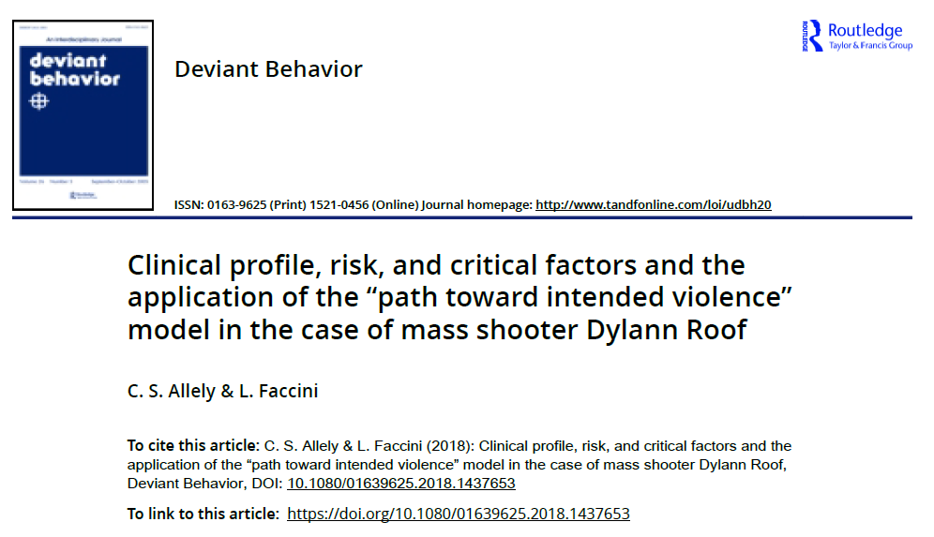
Notes:
Dylann Roof is an American white supremacist and mass murderer convicted in December 2016 of perpetrating the Charleston church shooting on June 17, 2015.
During a prayer service at Emanuel African Methodist Episcopal Church, Roof killed nine people, all African Americans, including senior pastor and state senator Clementa C. Pinckney, and injured one other person.

Slide 56
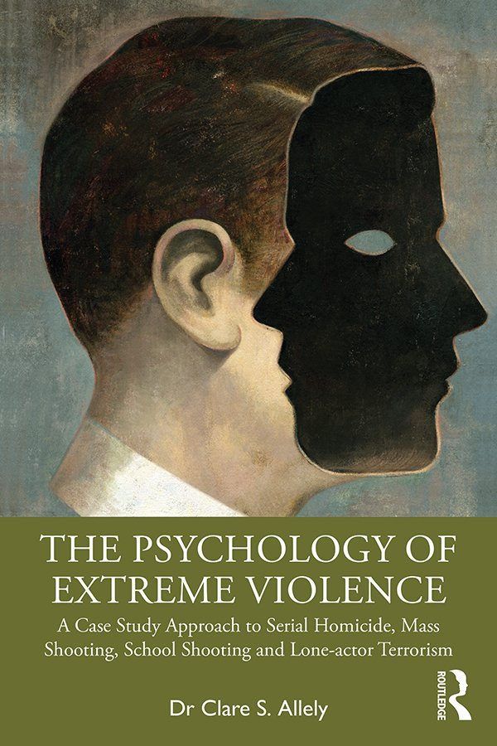
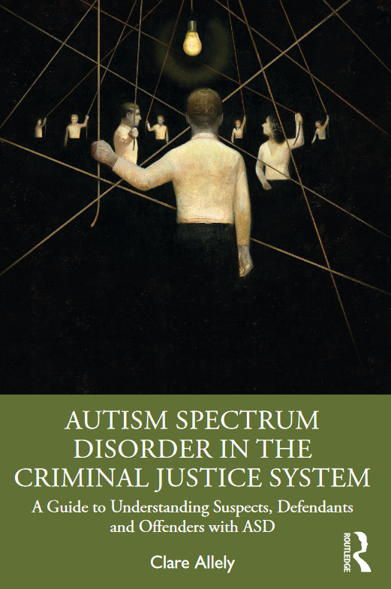

Slide 57
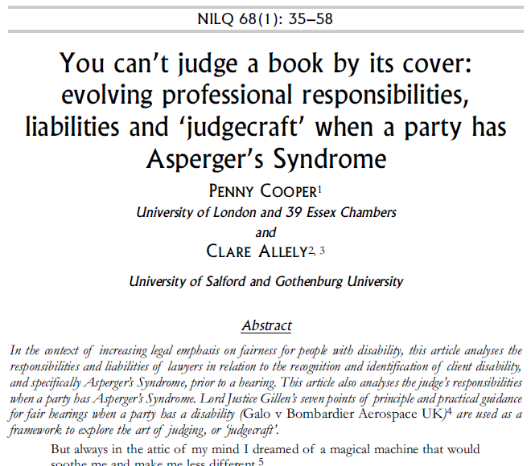
ASD in the Courtroom: Why it is Important to Recognise this Disorder in Defendants
There is a strong risk of a judge and jury drawing adverse inferences from a defendant with ASD’s demeanour, attitude and general comportment in court. They could – by virtue of their idiosyncrasies – be perceived as aloof, disinterested or even imperious to jurors unfamiliar with the disorder (O’Sullivan, 2018).
There are also a variety of behaviors that individuals with ASD (including individuals with high functioning ASD) can exhibit during court proceedings that may make them appear bizarre and misunderstood.

Slide 58
Some of the common features of ASD that might make a defendant with ASD appear evasive, remorseless, lacking in empathy and guilty
Issues with memory
Lack of outward emotional expression
Unusual ways of speaking
Inappropriate expressions or behaviours
Difficulty with making or maintaining eye contact
Literal cognitive style or interpretation of information (cognitive rigidity or inflexibility of thought)
Issues with compliance
Difficulty in recognising simple conventions in conversations (social cues)
Misinterpretation or lack of understanding of repetitive interests or behaviours
Presence of paranoia
Impaired social communication and interaction
Issues with time to respond
Echolalia or repetitive vocalisations
Notes:
Individuals with ASD tend to have a better memory for semantic and general information. However, they require more prompting in order to retrieve specific episodes (Crane & Maras, 2018).
5.2.1. Individuals with ASD are often impaired or have difficulty in their ability to recall events in a sequential manner (a clearly sequenced narrative of events) and with sufficient detail. This difficulty can make them appear to be uncooperative and even non-responsive when they are being questioned by police, attorneys, or judges (see also Kroncke, Willard, & Huckabee, 2016).
5.2.2. Another issue that is important to consider is ‘how long’ specific events lasted. This is something which can also be problematic because ASD may also have an impact upon an individual’s perception of time (The Advocate’s Gateway, 2016). There is increasing support for the theory that disorders in timing and/or time perception may possibly be a key feature, or cause of, some of the behavioural and cognitive impairments exhibited in individuals with ASD (e.g., Allman & DeLeon, 2009; Allman, DeLeon, & Wearden, 2011; Allman, 2011).
Difficulty recalling events in a sequential manner
Moreover, the language can be perceived by others as being “eccentric, tangential and overly formal” (Freckelton & List, 2009). They may also exhibit sudden and unexpected verbal utterances or unexpectedly speak at an increased volume. Individuals with ASD can have unusual or odd-sounding prosody. Individuals with ASD often speak in a monotonous voice (have no emotional intonation) with no variation in prosodic elements (e.g., speech rate and rhythm, pitch/fundamental frequency, loudness, intensity, duration and pause/silence) (McCann & Peppé, 2003).
Freckelton and List (2009) have also stated that individuals with ASD can be more mistrustful of others to a point bordering on paranoia when compared to individuals without ASD.

Slide 59
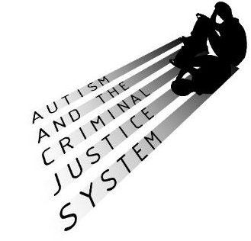

Professor Clare Allely
Contact me on e-mail: c.s.allely@salford.ac.uk
Follow me on twitter: @ClareAllely
Researchgate: https://www.researchgate.net/profile/Clare_Allely/research
Notes:
http://www.autismandcjs.org.uk/
http://www.keyring.org/cjs-easyreadexamples

