Slide 1


My Business Model Canvas
Purchasing and accounts
Business operations
Marketing and business strategy
Sales & business development
Key Partners
Key Activities
Value Proposition
Customer Relations
Customer Segments
Key Resources
Channels
Costs
Revenue
Find out more about the Business Model Canvas by visiting the authors website: https://strategyzer.com/

Slide 2
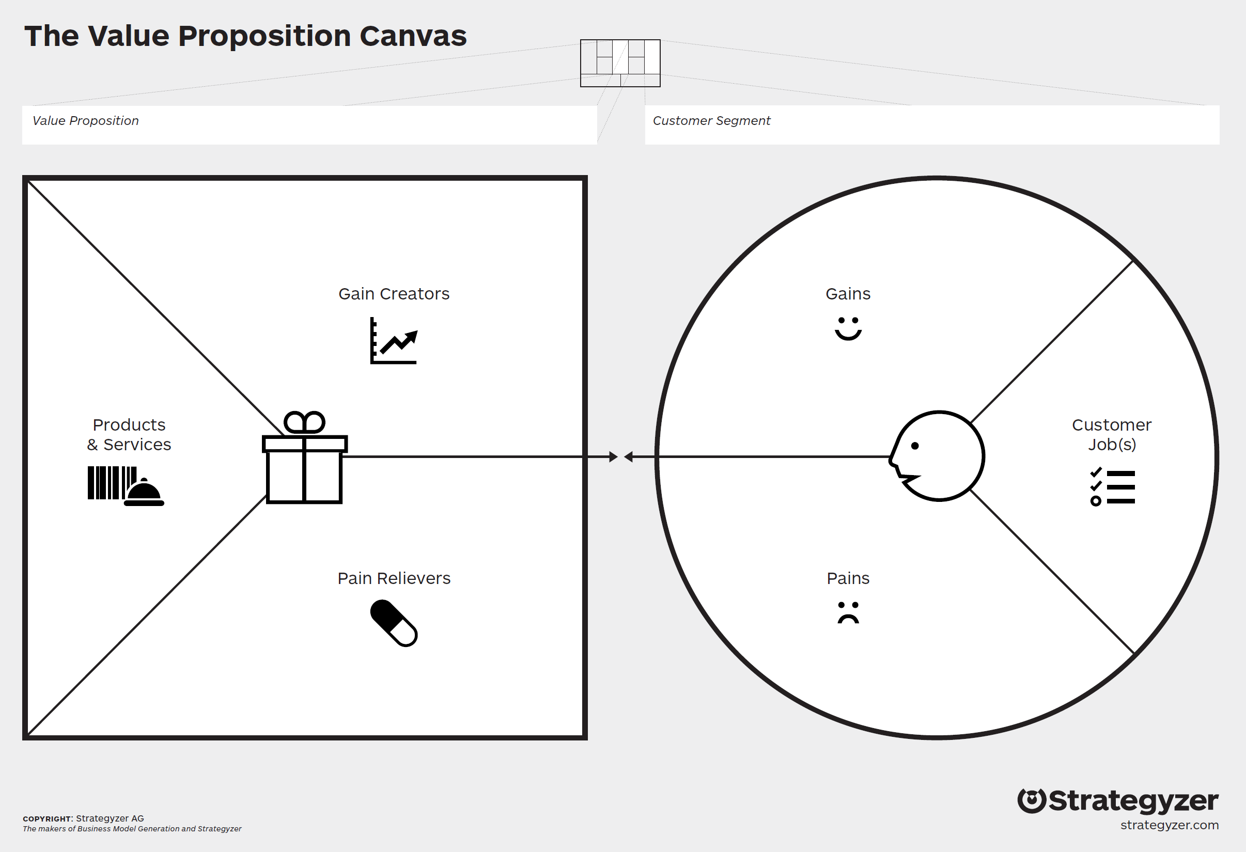
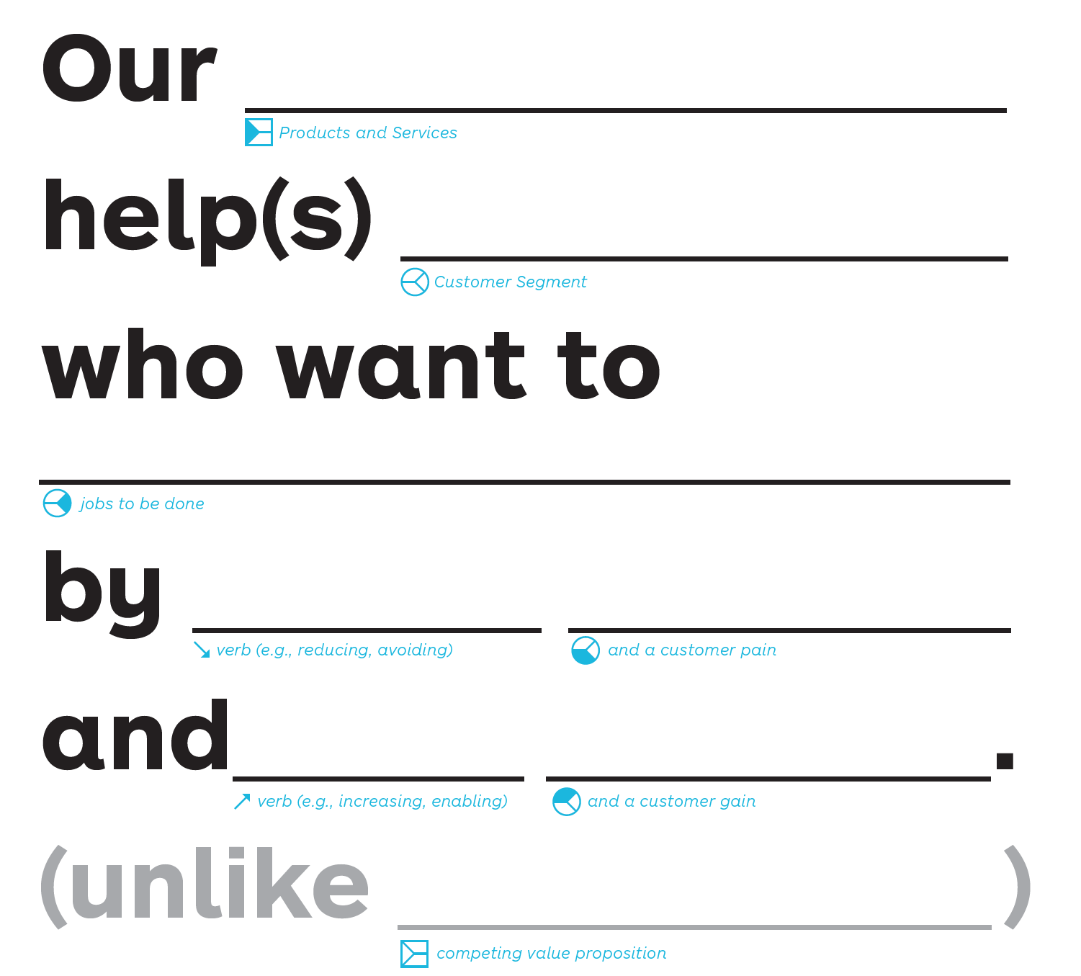
My Value Proposition Canvas

